Slide 1
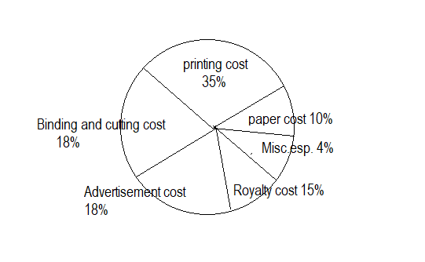
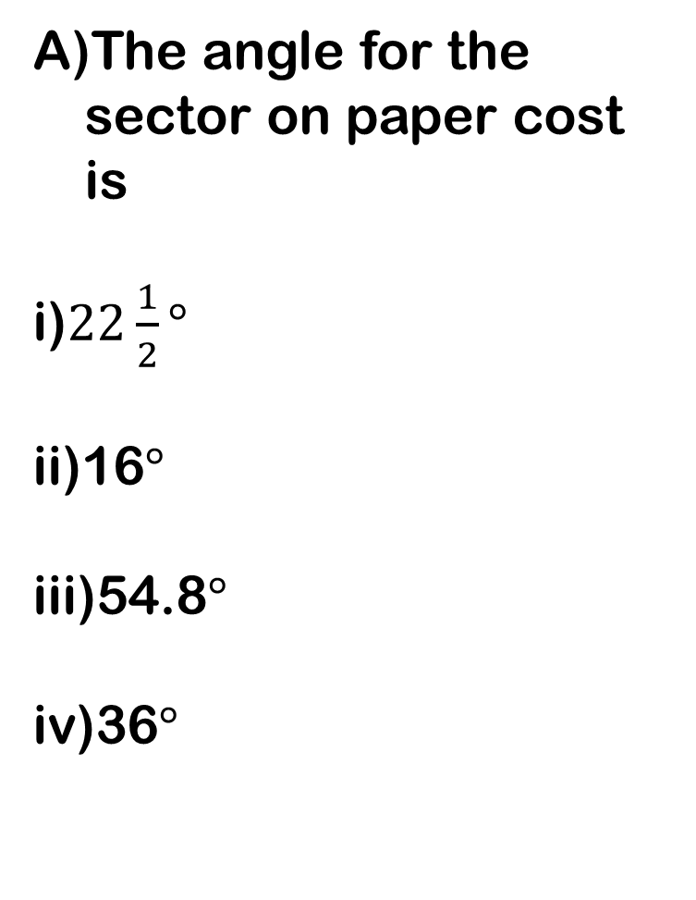
1.
The angle for the sector on paper cost is
i)$22\frac{1}{2}°$
ii)16$°$
iii)54.8$°$
iv)36$°$

Slide 2
B. If the printing cost is rs 17500, the royalty cost is
i)8750
ii)7500
iii)3150
iv)6300

Slide 3
C. If the miscellaneous expenses are rs 6000, how much more are binding and cutting cost than miscellaneous expenses?
i)23000
ii)21000
iii)18000
iv)15000

Slide 4
D. The paper cost is approximately what percent of printing cost ?
i)20.3%
ii)28.6%
iii)30%
iv)32.5%

Slide 5
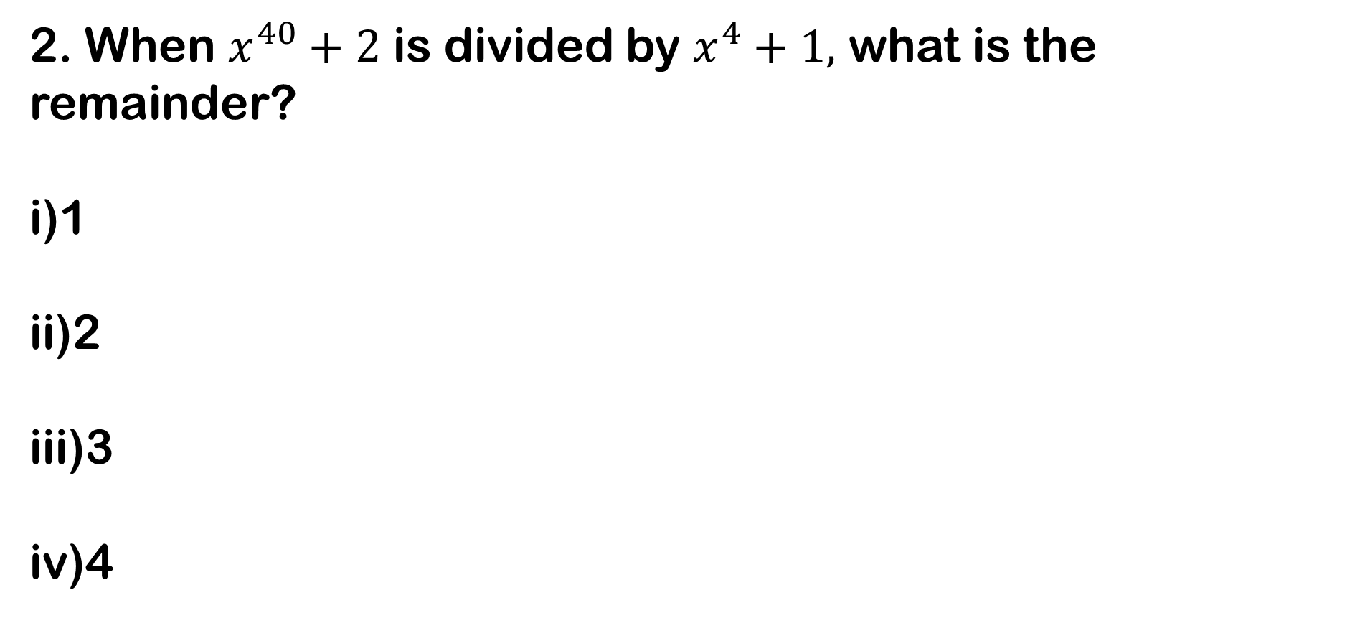
2. When $x^{40}+2$ is divided by $x^{4}+1,$ what is the remainder?
i)1
ii)2
iii)3
iv)4

Slide 6
3. On selling an article for Rs 240, a trader losses 4%. In order gain 10%, he must sell the article for
i)275
ii)280
iii)285
iv)300

Slide 7
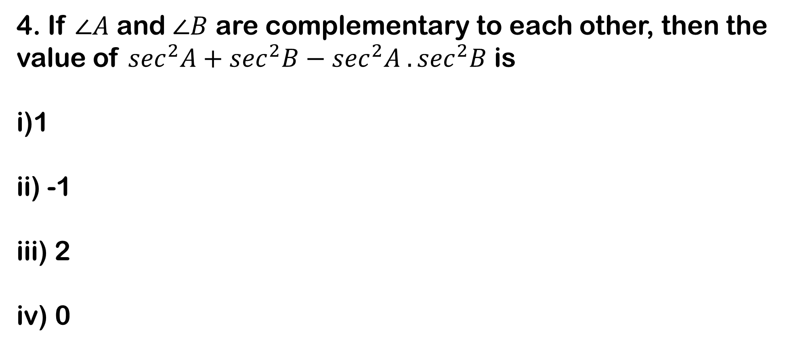
4. If $∠A$ and $∠B$ are complementary to each other, then the value of $\sec^{2}A+\sec^{2}B−\sec^{2}A . \sec^{2}B$ is
i)1
ii) -1
iii) 2
iv) 0

Slide 8

5. What is the LCM of $\frac{2}{3} ,\frac{7}{9} ,\frac{14}{15} ?$
i)$\frac{7}{3}$
ii)$\frac{14}{3}$
iii)$\frac{2}{3}$
iv)$\frac{1}{3}$

Slide 9
6. In an examination 70% of candidates passed in English, 80% passed in Mathematics, 10% failed in both subjects. If 144 candidates passed in both, the total number of candidates was
i)125
ii)200
iii)240
iv)375

Slide 10

7. If $2\sin{\frac{π}{2}}= x^{2}+\frac{1}{x^{2}} ,$then the value of $(x+\frac{1}{x})$
-1
2
1
0

Slide 11
8. A cylindrical tube open at both ends’ is made of metal. The internal diameter of the tube is 11.2 cm and its length is 21 cm. the metal everywhere is 0.4 cm thick. The volume of metal is ?
i)316 cm³
ii)310 cm³
iii)306.24 cm³
iv)280.52 cm³

Slide 12
9. The three medians AD, BE, and CF of triangle ABC intersect at point G. if the area of the triangle ABC is 60 sq. cm, then the area of the quadrilateral BDGF
i)10 sq cm
ii)15 sq cm
iii)20 sq cm
iv)30 sq cm

Slide 13
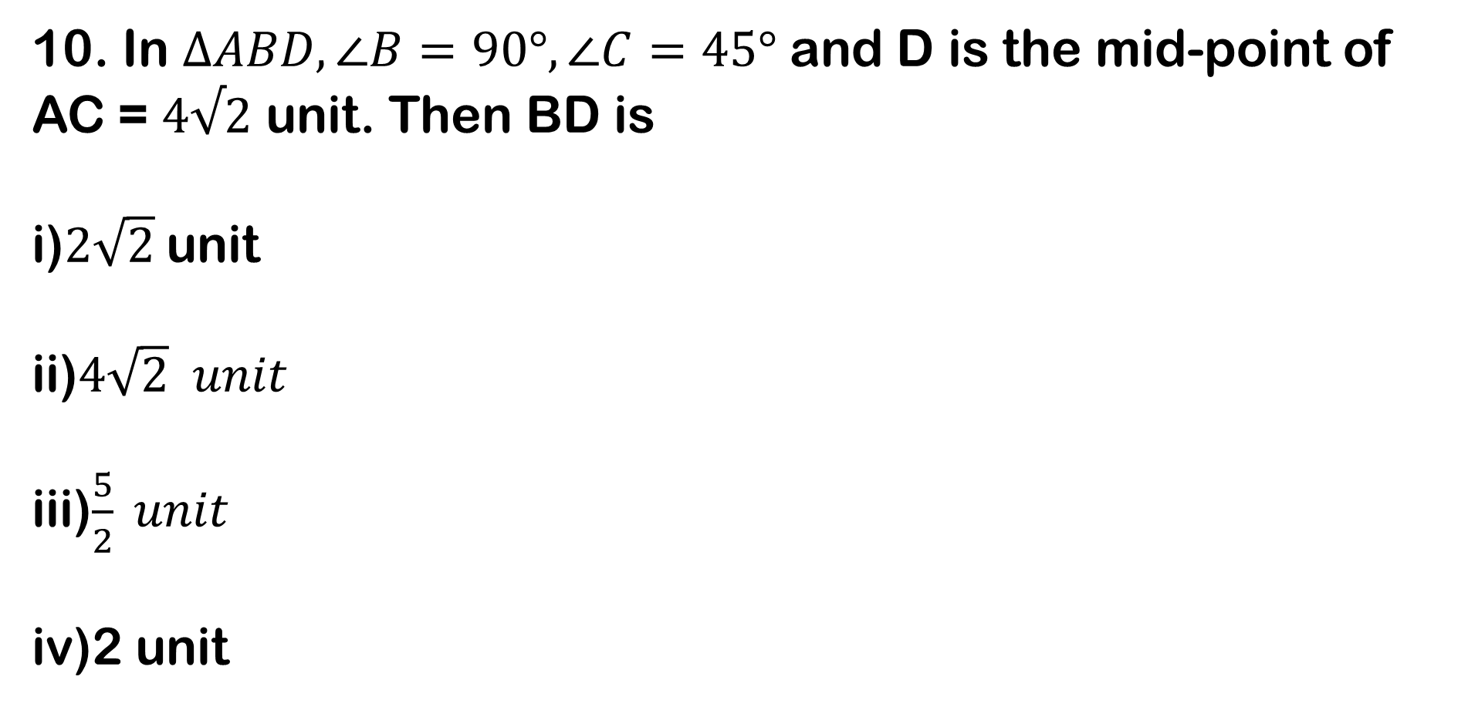
10. In $∆ABD, ∠B=90°, ∠C=45°$ and D is the mid-point of AC = $4√2$ unit. Then BD is
i)$2\sqrt{2}$unit
ii)$4\sqrt{2} unit$
iii)$\frac{5}{2} unit$
iv)2 unit

Slide 14
11. Complete the series
56, 90, 132, 184, 248, ?
i)368
ii)316
iii)362
iv)326

Slide 15
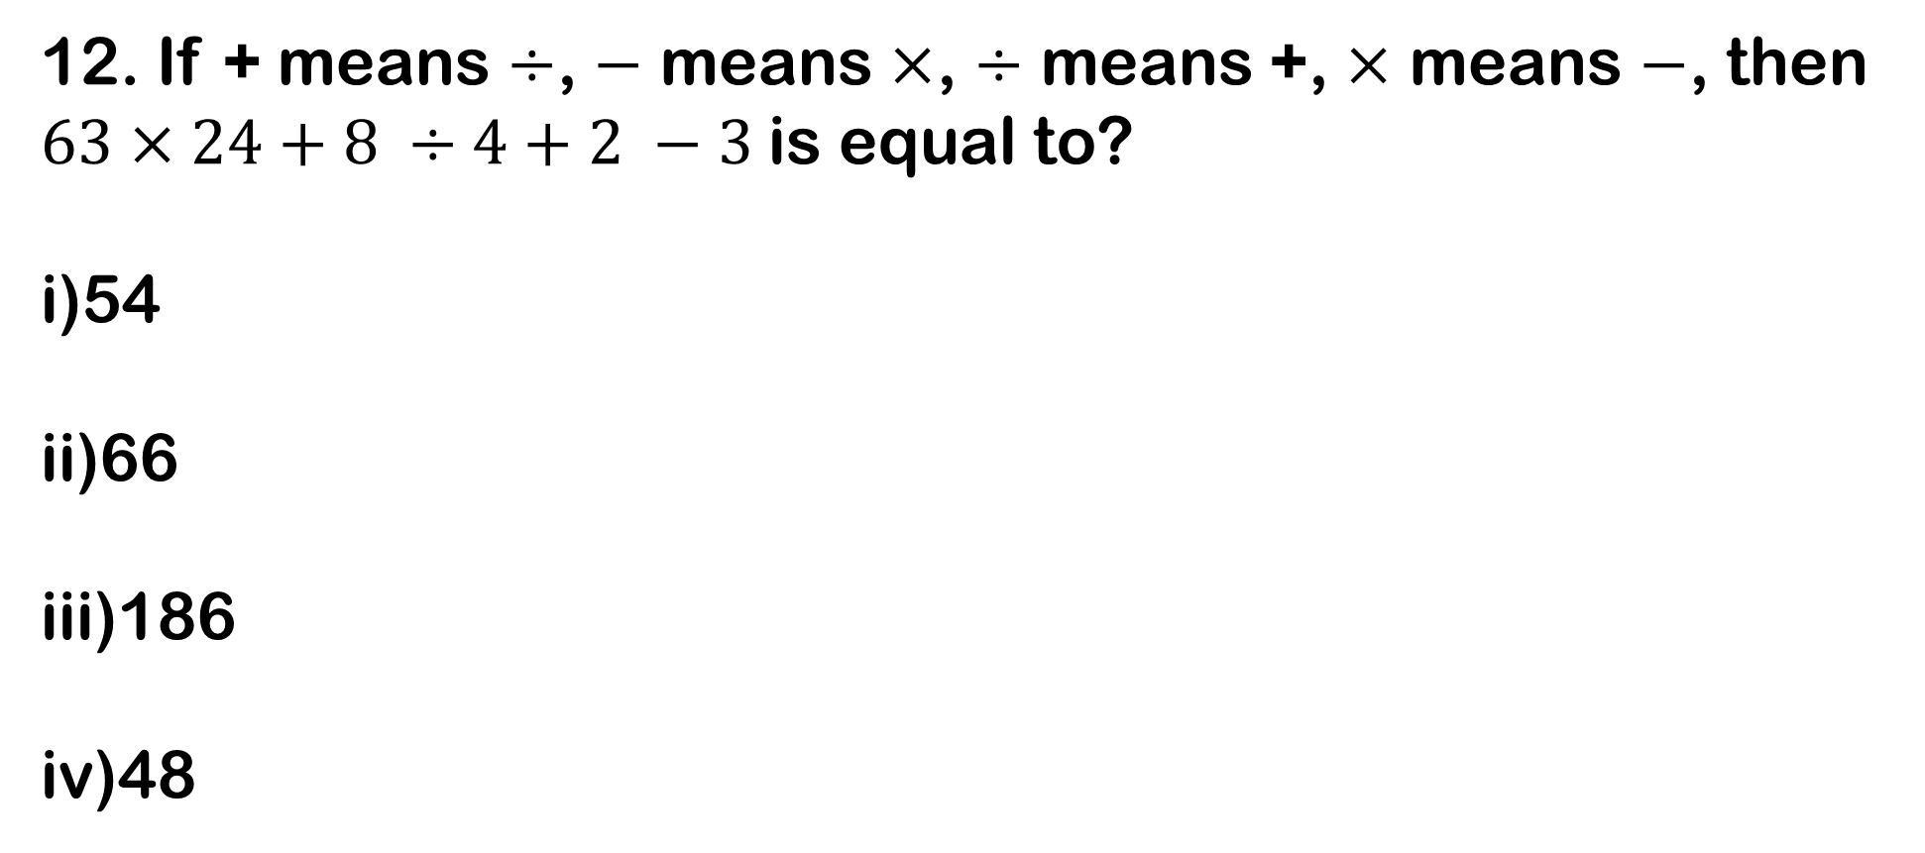
12. If + means $÷$, $−$ means $×$, $÷$ means +, $×$ means $−$, then $63×24+8 ÷4+2 −3$is equal to?
i)54
ii)66
iii)186
iv)48

Slide 16
13. Among six friends L, M, N, P, Q and S, each having different height. N is taller than Q and P but shortest than M. P is taller than only Q while S is shorter than only L. Which of the following pairs represents the tallest and shortest among six friends?
i)MP
ii)LQ
iii)PQ
iv)MQ

Slide 17
14. Nitin correctly remembers that Nidhi’s birthday is before Friday but after Tuesday. Deepak correctly remembers that Nidhi’s birthday is after Wednesday but before Saturday. On which day does Nidhi’s birthday definitely fall?
i)Monday
ii)Tuesday
iii)Wednesday
iv)Thursday

Slide 18
15. Out of 6 members panel sitting in a row U is to the left of V but on the right on the right W who is to the right of X and Y is at the right of Z who is to the left of X . Find the members sitting in the middle .
i)ZY
ii)XW
iii)UV
iv)WV

Slide 19
16. Find the missing number

Slide 20
17. Arun started from point A , and walked 10 km East to point B, then turned to North and walked 3 km to point C and then turned West and walked 12 km to point D, then again turned South and walked 3 km to point E. In which direction is he from starting point?
i)East
ii)South
iii)West
iv)North

Slide 21
18. Statements : Irregularity is a cause for failure
Some regular students fail in the examination
Conclusions : i)All failed students are regular.
ii)All successful students are not regular.
i follows
ii follows
Neither follows
Both follows

Slide 22

19. Find the number of triangles in the given figure.
i)10
ii)19
iii)21
iv)23

Slide 23
20. SCD, TEF, UGH, ____, WKL
i)CMN
ii)UJI
iii)VIJ
iv)IJT

Slide 24
21. Read each sentence to find out whether there is any grammatical error in it. The error, if any will be in one part of the sentence. The letter of that part is the answer. If there is no error, the answer is ‘iv'. (Ignore the errors of punctuation, if any).
solve as per the direction given above
i)We discussed about the problem so thoroughly
ii)on the eve of the examination
iii)that I found it very easy to work it out.
iv)No error.

Slide 25
22. In questions given below, a part of the sentence is italicised and underlined. Below are given alternatives to the italicised part which may improve the sentence. Choose the correct alternative. In case no improvement is needed, option ‘iv' is the answer.
The workers are hell bent at getting what is due to them.
i)hell bent on getting
ii)hell bent for getting
iii)hell bent upon getting
iv)No improvement

Slide 26
23.
A))) Today most businessmen are very worried. To begin with, they are not used to competition . In the past they sold whatever ...(1)... produced at whatever prices they chose. But ...(2)... increasing competition, customers began to ...(3)... and choose. Imports suddenly became ...(4)... available and that too at cheaper ...(5)...
1) solve as per the direction given above
i)it
ii)he
iii)they
iv)we

Slide 27
B))Today most businessmen are very worried. To begin with, they are not used to competition . In the past they sold whatever ...(1)... produced at whatever prices they chose. But ...(2)... increasing competition, customers began to ...(3)... and choose. Imports suddenly became ...(4)... available and that too at cheaper ...(5)...
2)solve as per the direction given above
i)with
ii)by
iii)after
iv)from

Slide 28
C))Today most businessmen are very worried. To begin with, they are not used to competition . In the past they sold whatever ...(1)... produced at whatever prices they chose. But ...(2)... increasing competition, customers began to ...(3)... and choose. Imports suddenly became ...(4)... available and that too at cheaper ...(5)...
3)solve as per the direction given above
i)buy
ii)take
iii)pick
iv)want

Slide 29
D))Today most businessmen are very worried. To begin with, they are not used to competition . In the past they sold whatever ...(1)... produced at whatever prices they chose. But ...(2)... increasing competition, customers began to ...(3)... and choose. Imports suddenly became ...(4)... available and that too at cheaper ...(5)...
4)solve as per the direction given above
i)hardly
ii)easily
iii)frequently
iv)conveniently

Slide 30
E))Today most businessmen are very worried. To begin with, they are not used to competition . In the past they sold whatever ...(1)... produced at whatever prices they chose. But ...(2)... increasing competition, customers began to ...(3)... and choose. Imports suddenly became ...(4)... available and that too at cheaper ...(5)...
5)solve as per the direction given above
i)costs
ii)returns
iii)dividend
iv)prices

Slide 31
24.
A))Extreme old age when a man behaves like a fool
i)Imbecility
ii)Senility
iii)Dotage
iv)Superannuation
B))That which cannot be corrected
i)Unintelligible
ii) Indelible
iii) Illegible
iv) Incorrigible

Slide 32
25. Change the speech
"If you don't keep quiet I shall shoot you", he said to her in a calm voice.
i)He warned her to shoot if she didn't keep quiet calmly.
ii)He said calmly that I shall shoot you if you don't be quiet.
iii)He warned her calmly that he would shoot her if she didn't keep quiet.
iv)Calmly he warned her that be quiet or else he will have to shoot her.

